Slide 1

Powder Coating Oven
By
Verina Abdelmesih
Hussain Alismail
Desiree dee
Amber malenowsky

Slide 2
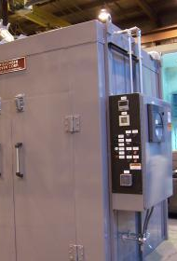
Project Description
Goal
Design a mobile powder coating oven that can be used by all programs
Work with the bumper capstone team
Powered by a propane fueled torpedo heater
Controlled using a PID control system
Stakeholder
The Renewable Energy Lab
Client
Carson Pete
The powder coating machine will be housed in the renewable energy lab
Figure 1: Industrial powder coating batch ovens [1]

Slide 3
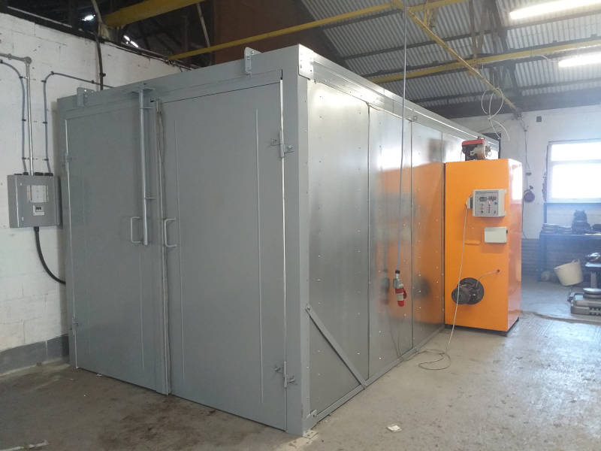

Background
What is Powder-Coating?
It’s the process of applying fine, pigment particles are electrically charged and sprayed onto the part.
What projects can you do with powder coating?
It could be applied from Simple DIYs to High end industrial applications.
Powder-Coating ovens?
The last step for powder coating to cure the powder onto the part.
Figure I: Industrial Powder-Coating Oven [2]
Gif I: Powder-Coating [3]

Slide 4
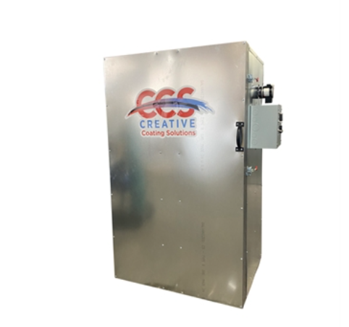
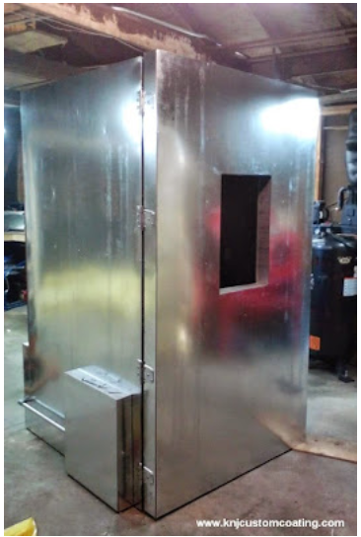
Benchmarking
Figure 3: Creative Coating Solutions [4]
Figure 4: DIY Powder Coating Oven [5]

Slide 5
Literature Review (Structure)
[6] "A look into the Making of Powder Coating Ovens”
Summary: A detailed instructions on how to design and fabricate a powder coating oven.
[7] "What Size Powder Coating Oven Do You Need?”
Summary: Size measurements and configurations for the design of powder coating oven.
[8] "Curing oven Structural Design and Numerical Simulation of Powder Electrostatic Spraying Curing Oven“
Summary: A study of the heat and structural analysis that determines the best powder coating outcome with least energy spent.
Notes:
Hussain

Slide 6
Literature Review (Heater)
[9] “The Effect of Oven-Heat Flux on Powder-Coating Issues of Sheet Molding Compound Panels”
Summary: The general process of powder coating and heat flux in an oven. This source helps the team choose the type of oven used.
[10] EPTEX Coating
Summary: Oven/ heater spec for a comparable item available in current market.
[11] “How Oven Conditions Affect Powder Coating Performance”
Summary: Changing the temperature and time of the oven to work with the number of parts and density of the objects in the oven.
[12] “Understanding Cure Ovens for Powder Coating”
Summary: Conditions to review about curing powder coating when choosing a heater/oven
Notes:
Amber

Slide 7
Literature Review (Control System)
[13] “What is a PID controller?”
Summary: Details the history of the PID controller
[14] “Manuals, Manuals : Auber Instruments, Inc., Temperature control solutions for home and industry. "
Summary: Details how to set up a PID system
[15] “What is a PID temperature controller?”
Summary: Details different methods of use for a PID sensor
Notes:
Verina

Slide 8
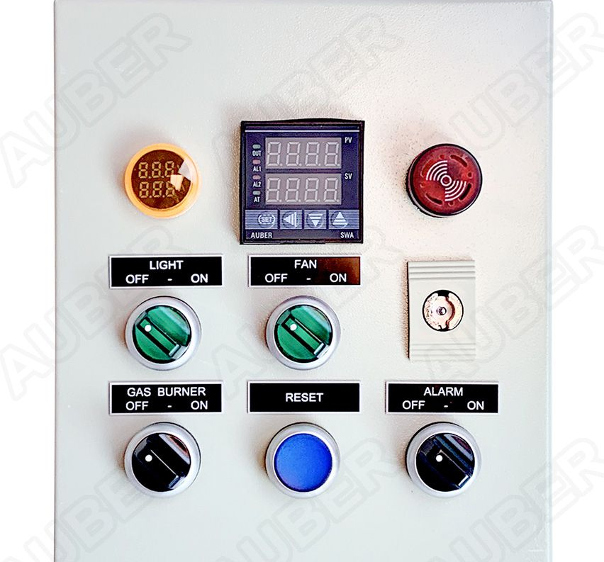
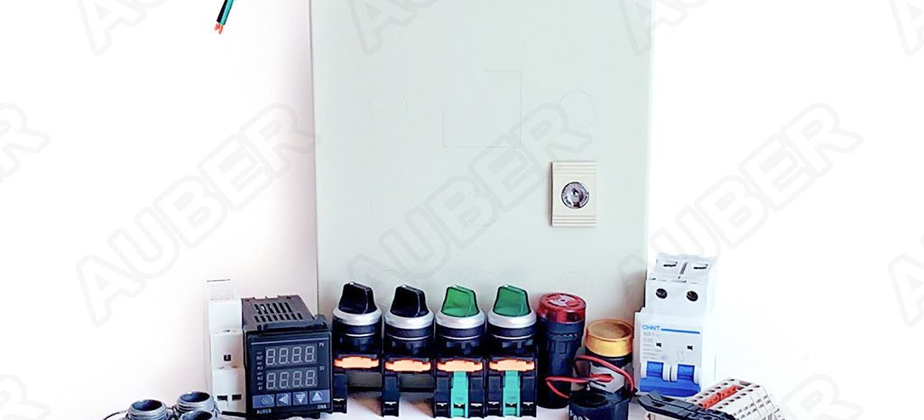
Literature Review (Control System)
Continued
This is an example of a PID control Panel kit that may be used for this project
List of materials include:
10x8x8" Wall mount enclosure with knockouts and a set of hangers.
Dual-line display PID controller with a built-in timer function.
2P 25A 110V DIN Rail mounted contactor.
Black 2P selector switch for burner ON/OFF control.
Oven temperature probe w/ mounting screw (both sensor and cable are rated for 900 º F).
Figure 6 and 7: Gas oven controller kit [16]

Slide 9
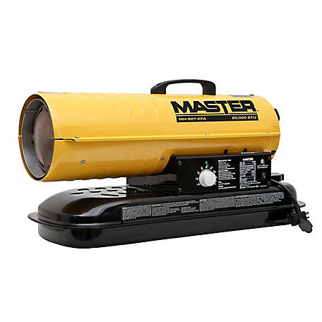
Customer Needs
After a discussion with the client these were found to be the most important customer needs
Propane fueled heater
Control system for the heater
Retractable rack system
Withstand 500 degrees F
Dimensions/Size
Portability
Weather Resistant
Figure 8: Propane forced air torpedo heater [17]

Slide 10
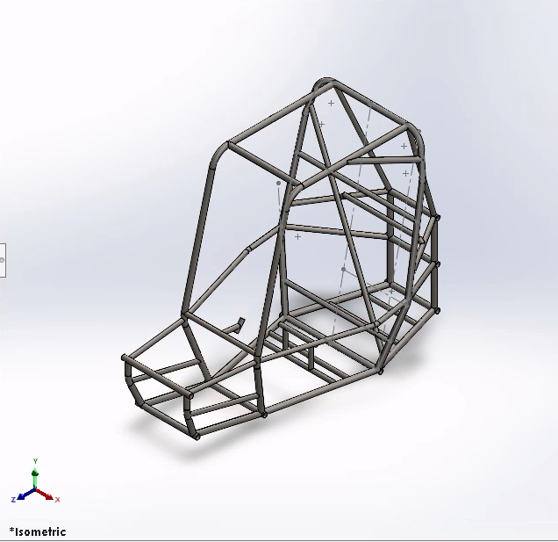
Engineering Requirements
PID temperature and time monitor
Corrosion Protected exterior
Volume: 6.5' x 4' x 5.5' (L x W x H)
Material Costs
Heat Circulation and Ventilation
Design Assembly/Disassembly
Heat Output of 500 °F

Slide 11
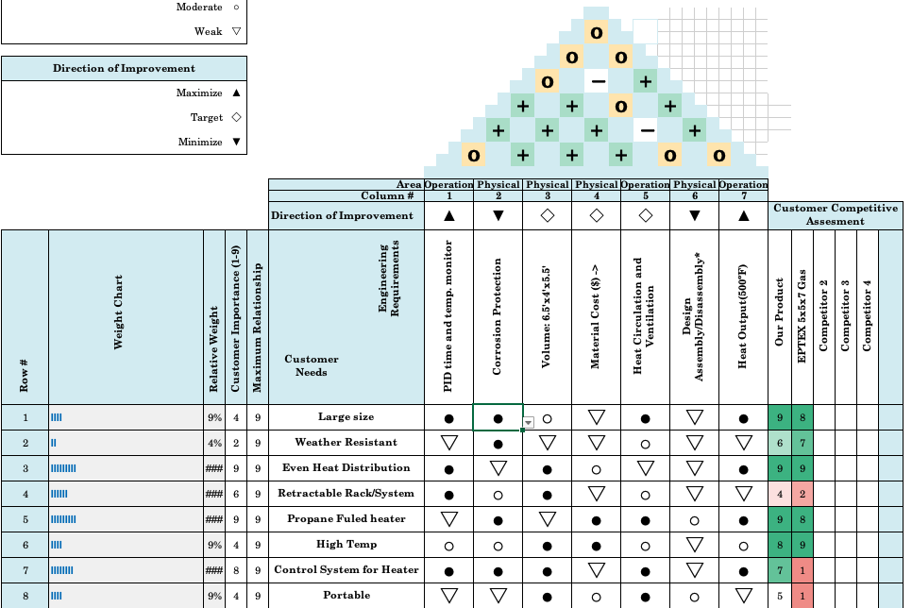
QFD

Slide 12
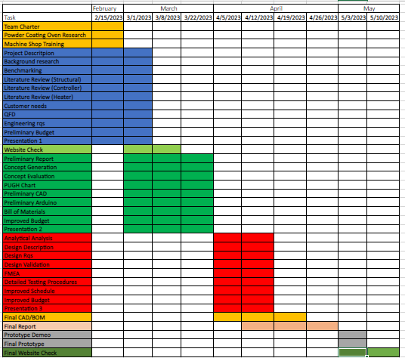
Schedule

Slide 13
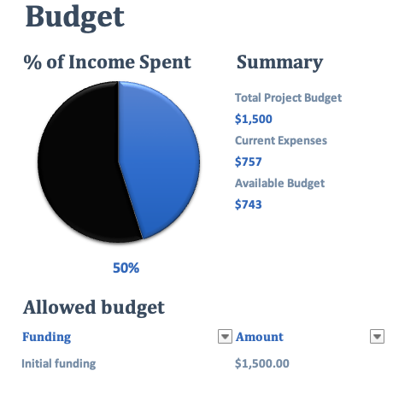
Budget
Target budget for oven build: $1000 to $1500
Current expenses are estimated
Torpedo propane heater, high temp fan and mineral wool insulation
Available Budget will be allocated to galvanized steel framing, interior and exterior 16 to 20-gauge galvanized steel sheets
Expected Prototyping costs: $40 to $60

Slide 14
References
[1] “Industrial powder coating batch ovens,” Industrial Powder Coating Batch Oven | Batch Curing Oven | Wisconsin Oven. [Online]. Available: https://www.wisoven.com/products/batch-ovens/powder-coating-batch-ovens. [Accessed: 08-Mar-2023].
[2] “Industrial powder coating curing ovens,” UK Powder Coating, 14-Dec-2022. [Online]. Available: https://ukpowdercoating.com/gas-powered-powder-curing-ovens/. [Accessed: 27-Feb-2023].
[3] Gfycat, “Best powder coating gifs,” Gfycat. [Online]. Available: https://gfycat.com/gifs/search/powder+coating. [Accessed: 28-Feb-2023].
[4] “Ovens,” Powder Coating Ovens. [Online]. Available: https://www.creativecoatingsolutions.com/ovens-powder-coating.htm. [Accessed: 07-Mar-2023].
[5] S. Castle, “Powder coating ovens,” Powder Coating: The Complete Guide. [Online]. Available: https://www.powdercoatguide.com/2012/12/beginner-ovens.html. [Accessed: 07-Mar-2023].
[6] Shivang Furnaces, “New innovative things - laboratory oven manufacturers.,” Superior quality and affordable powder coating oven manufacturers, 15-Feb-2016. [Online]. Available: https://www.shivangfurnace.com/articles/a-look-into-the-making-of-powder-coating-ovens.html. [Accessed: 08-Mar-2023].
[7] R. News, “What size powder curing oven do you need for your industrial powder coating operation? reliant finishing system,” Reliant Finishing Systems, 26-Mar-2021. [Online]. Available: https://reliantfinishingsystems.com/what-size-powder-coating-oven-do-you-need/. [Accessed: 08-Mar-2023].
[8] E. Lee, “Curing oven structural design and numerical simulation of powder electrostatic spraying curing oven,” LinkedIn. [Online]. Available: https://www.linkedin.com/pulse/curing-oven-structural-design-numerical-simulation-powder-ella-lee?trk=articles_directory. [Accessed: 08-Mar-2023].

Slide 15
References
[9] S. K. Basu, B. Shah, and H. G. Kia, “The Effect of Oven-Heat Flux on Powder-Coating Issues of Sheet Molding Compound Panels,” Industrial & engineering chemistry research., vol. 48, no. 3, pp. 1638–1649, 2009, doi: 10.1021/ie801130g.
[10] EPTEX Coating https://www.eptexcoatings.com/product/5x5x7-gas-powder-coating-oven/
[11] “How Oven Conditions Affect Powder Coating Performance,” Focus on powder coatings, vol. 2018, no. 11, pp. 6–6, 2018, doi: 10.1016/j.fopow.2018.10.028.
[12] R. TALBERT, “Understanding Cure Ovens for Powder Coating,” Industrial paint & powder, vol. 76, no. 11, p. 24–, 2000.
[13] O. Engineering, “What is a PID controller?,” https://www.omega.com/en-us/, 28-Sep-2022. [Online]. Available: https://www.omega.com/en-us/resources/pid-controllers. [Accessed: 08-Mar-2023].
[14] Auberins.com, “Manuals,” Manuals : Auber Instruments, Inc., Temperature control solutions for home and industry. [Online]. Available: https://www.auberins.com/index.php?main_page=page&id=34. [Accessed: 08-Mar-2023].
[15] “What is a PID temperature controller?,” West Control Solutions. [Online]. Available: https://www.west-cs.com/products/l2/pid-temperature-controller/. [Accessed: 08-Mar-2023].
[16] Auberins.com, “Gas oven controller kit (120V gas burner),” Gas Oven Controller Kit (120V Gas Burner) [KIT-GSO102S] - $319.99 : Auber Instruments, Inc., Temperature control solutions for home and industry. [Online]. Available: https://www.auberins.com/index.php?main_page=product_info&cPath=86_88&products_id=887. [Accessed: 08-Mar-2023].
[17] “Master propane forced air torpedo heater, 125,000 BTU, MH-125V-GFA at ...” [Online]. Available: https://www.tractorsupply.com/tsc/product/master-propane-forced-air-torpedo-heater-125-000-btu. [Accessed: 08-Mar-2023].

